Slide 1
CLASS X SCIENCE
ACIDS BASES AND SALTS (CHAPTER-2)

Slide 2
INTRODUCTION
ACIDS are
- Sour in taste
-Changes the blue colour of blue litmus to red
- Common examples are citric acid, lactic acid
BASES are
- bitter in taste & soapy to touch
- Changes the red colour of red litmus to blue
- Common examples are washing soda, baking soda

Slide 3
INDICATORS AND THEIR COLOUR CHANGES
SAMPLE SOLUTIONS | LITMUS | PHENOPHTHALEIN | METHYL ORANGE
ACID | BLUE TO RED | COLOURLESS | RED
BASE | RED TO BLUE | PINK | YELLOW

Slide 4
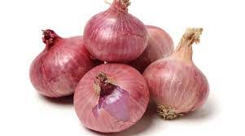
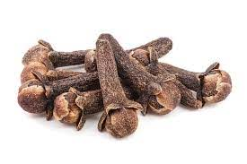
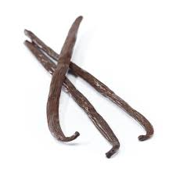
OLFACTORY INDICATORS
Substances whose odour (smell) changes in acidic or basic media are called olfactory indicators. The common olfactory indicators are
onion cloves vanilla

Slide 5
How do acids and bases react with metals?
Acids react with metals to form salt and hydrogen gas
ACID + METAL--------------→ SALT + HYDROGEN
eg:- Zn + 2HCl---------------→ ZnCl₂ + H₂
Fe + H₂SO₄-----------→ FeSO₄ +H₂
Bases also react with metal to form hydrogen
BASE + METAL--------------→ SALT + HYDROGEN
Eg:- 2NaOH +Zn -------------→ Na₂ZnO₂ +H₂

Slide 6
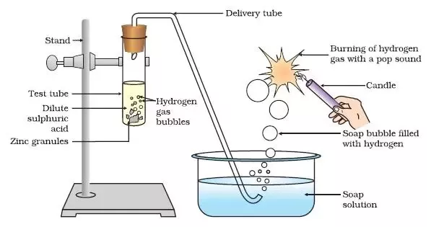
Hydrogen gas burns with a pop sound

Slide 7
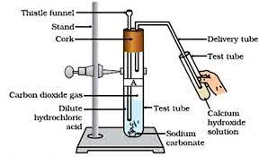
How do metal carbonates & bicarbonates react with acids?
Metal carbonates/Bicarbonates + Acid -----→Salt +Water+ Carbon dioxide
Na₂CO₃ + 2HCl----------------→ 2NaCl + H₂O + CO₂
NaHCO₃ +HCl-----------------→ NaCl + H₂O + CO₂

Slide 8
Detection of carbon dioxide
Carbon dioxide turns lime water milky due to the formation of calcium carbonate
Ca(OH)_{2 (aq)} + CO_{2 (g)} -------------→ CaCO_{3 (s)} +H₂O _{(l)}
On passing excess carbon dioxide the milkiness disappear due to the formation of soluble calcium bicarbonate
CaCO_{3 (s)} + H₂O _{(l)} + CO_{2 (g)} -------------→ Ca(HCO₃)_{2 (aq)}
(soluble in water)

Slide 9
How do acids and bases react with each other?
The effect of an acid is nullified by a base and vice versa
Acid and base react with each other to form salt and water. This reaction is called NEUTRALISATION REACTION
Example NaOH + HCl -------------→ NaCl + H₂O
Ca(OH)₂ + H₂SO₄ ------------→ CaSO₄ + 2 H₂O
General Equation:- Acid + Base ------------→ Salt + Water

Slide 10
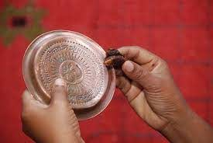
Reaction of metallic oxide with acids
Why do we use tamarind, lemon etc to clean metal vessels?
The coating over the metal vessels (metal oxide) reacts with acid and get dissolved forming salt and water
METAL OXIDE + ACID --------→ SALT + WATER
This is similar to reaction of a base
So metal oxides are BASIC in nature.

Slide 11
Reaction of non metallic oxides with base
Non metal oxide react with base to form salt and water just like acids
Ca(OH)_{2 (aq)} + CO_{2 (g)} -------------→ CaCO_{3 (s)} +H₂O _{(l)}
base non metaloxide salt water
This reaction shows that non metallic oxides are ACIDIC in nature.

Slide 12
What do all acids have in common?
All acids produce hydrogen ion (H⁺) or hydronium ion(H₃O⁺)in the presence of water
HCl +H₂O --------------→ Cl⁻ + H₃O⁺
H+/H₃O⁺ is responsible for the electrical conductivity of acidic solutions
Some substances do not form H+ ions in aqueous solution even though element hydrogen is present in the compound. They are not acids. Example glucose, alcohol etc

Slide 13
What have all bases in common?
All bases produce hydroxide ion (OH⁻) or hydroxyl ion in the presence of water
NaOH_{(aq)} --------------→ OH⁻_{(aq)} + Na⁺_{(aq)}
Ca(OH)_{2(aq)} ------------→ 2OH⁻_{(aq)} +Ca²⁺ _{(aq)}
Hydroxide ion is responsible for the electrical conductivity of basic solutions

Slide 14
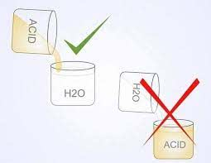
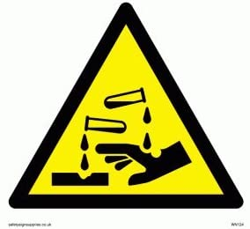
Dilution of acids
Acid must be slowly added to water, Since dilution is exothermic
Otherwise it may cause burns due to acid splash and can cause breakage of glass containers.
Mixing an acid or base with water decreases the
concentration of ions per unit volume

Slide 15
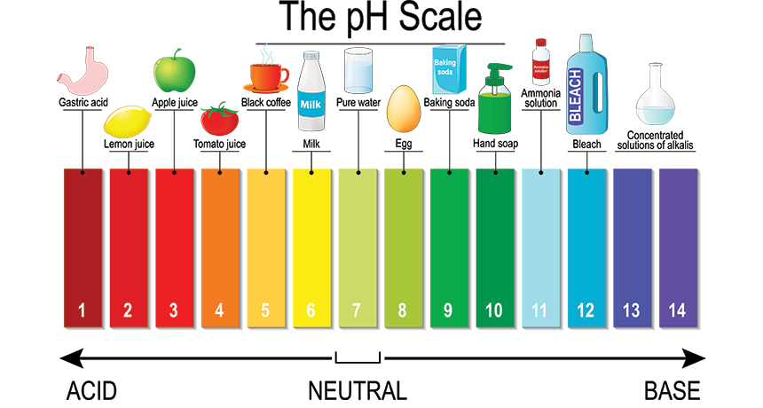
pH scale
It is a scale for measuring hydrogen ion concentration in a solution

Slide 16
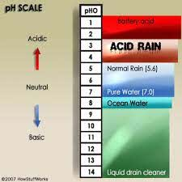
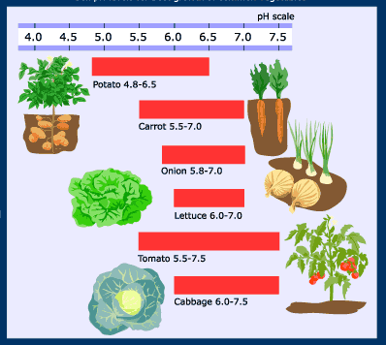
Importance of pH in everyday life
Our body pH is 7.0 to 7.8
When rain water has pH less than 5.6 it is acid rain
Plants need a specific pH for the growth. So we need to check the soil pH

Slide 17
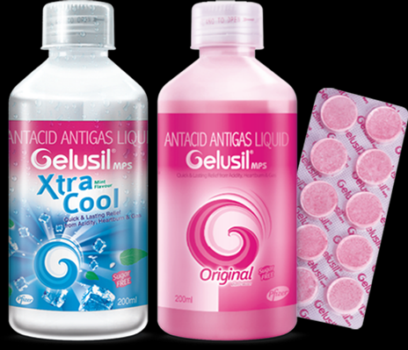
Our stomach produces hydrochloric acid. Too much of acid causes
indigestion, pain and irritation.
To get rid of the acidity bases called ANTACIDS are used.eg:-milk of magnesia.

Slide 18
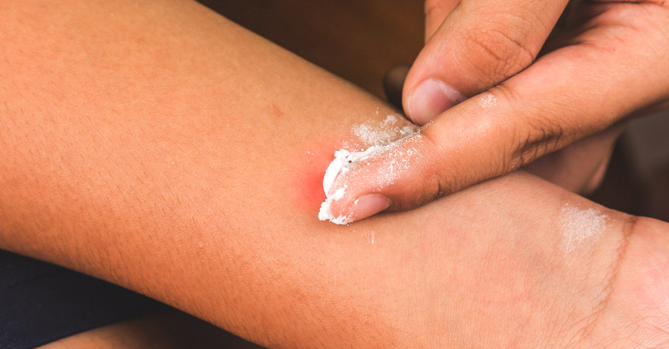
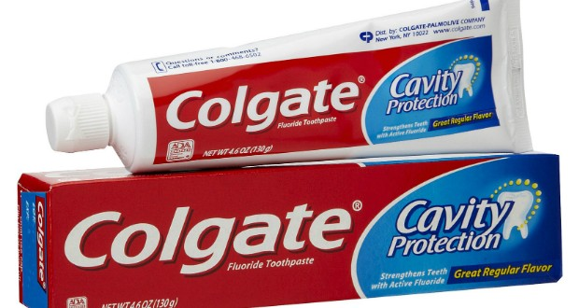
Tooth enamel (calcium phosphate) gets corroded by acids produced by bacteria which acts on food particles remaining in our mouth.
To prevent this we use tooth pastes which are basic
Bees and ants inject acid when they sting. So a mild base on the stung area gives relief. You can use soap / tooth paste/ baking soda

Slide 19
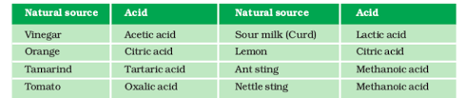
Some naturally occurring acids

Slide 20
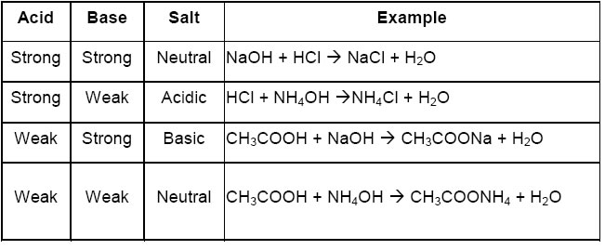
pH of salts
An salt is formed by the reaction between an acid and a base.
The pH of salts depends on the strength of original acid and base

Slide 21
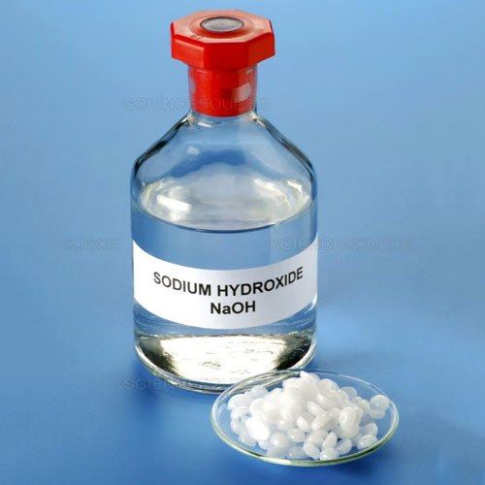
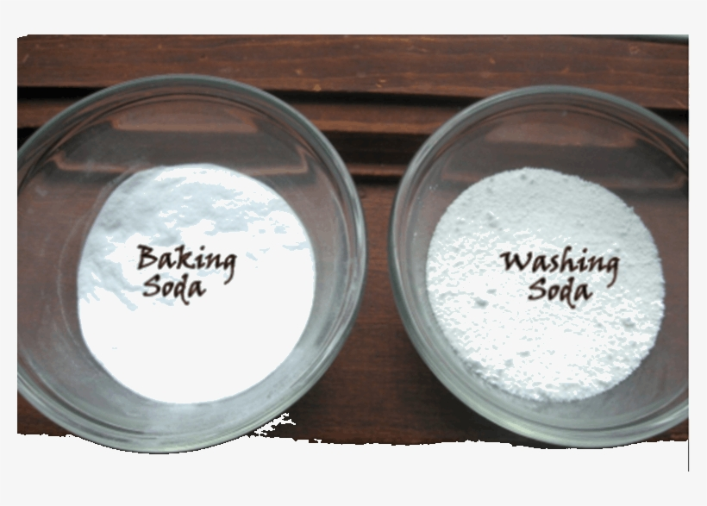
Chemicals from common salt
Common salt( Sodium chloride) is an important raw material for substances like sodium hydroxide, bleaching powder, baking soda, washing soda and many more

Slide 22
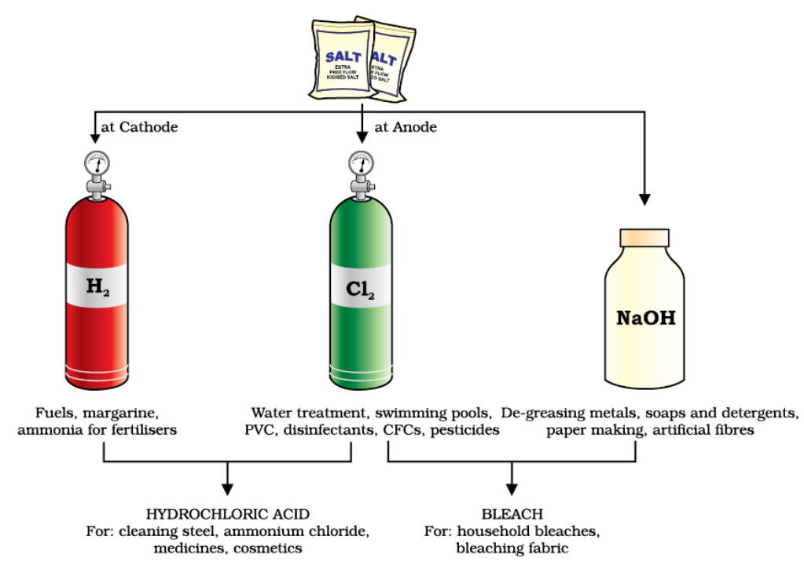
Sodium hydroxide (NaOH)
When electricity is passed through brine(aq solution of sodium chloride), chlorine is formed at anode and hydrogen at cathode. NaOH is formed near cathode. This process is known as CHLOR-ALKALI process.
2NaCl +2H₂O----------------→ 2NaOH + H₂+Cl₂

Slide 23
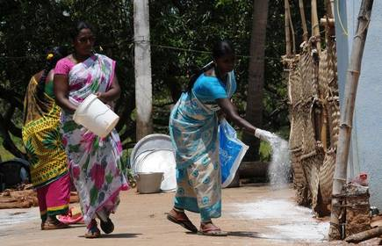
Bleaching powder- calcium oxy chloride- CaOCl₂
It is formed by the action of chlorine on dry slaked lime
Ca(OH) ₂ + Cl₂--------------→ CaOCl₂ + H₂O
Uses
For bleaching cotton, linen, wood pulp
As an oxidizing agent
For disinfecting

Slide 24
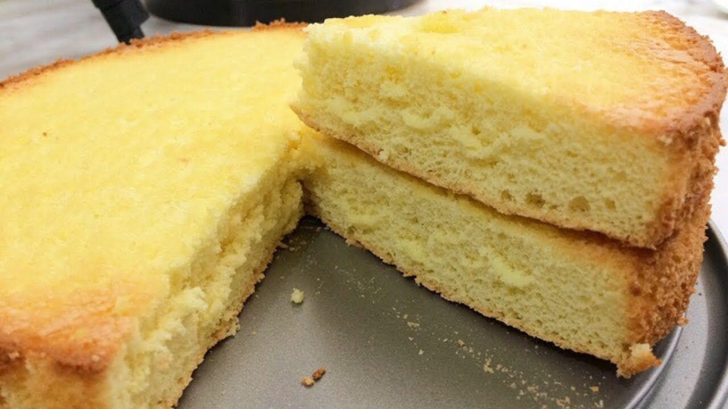
Baking soda- sodium bicarbonate- NaHCO₃
Preparation : NaCl +H₂O +NH₃ +CO₂----------------→NH₄Cl + NaHCO₃
On heating it produces large amount of carbon dioxide
2NaHCO₃ ----------------------→ Na₂CO₃ +H₂O +CO₂
Uses
For making baking powder (a mixture of baking soda + edible acid like tartaric acid) .

Slide 25
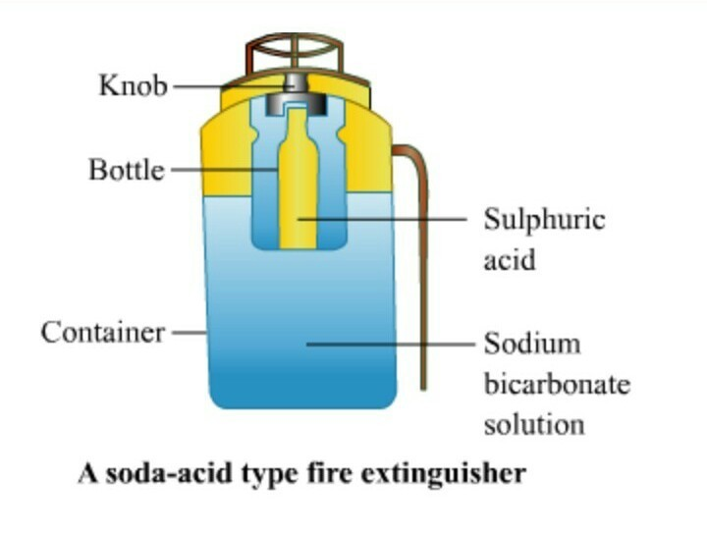
Uses of baking soda
Cake becomes soft and spongy because baking powder when mixed in water or heated the following reaction takes place
NaHCO₃ + H⁺----------------→ CO₂ +H₂O + sodium salt of acid
As an antacid against acidity
In fire extinguishers

Slide 26
Washing soda- Sodium carbonate deca hydrate Na₂CO₃ 10 H₂O
Preparation : Recrystallisation of sodium carbonate
Na₂CO₃ +10 H₂O -------------→ Na₂CO₃10H₂O
Uses
In the manufacture of glass, cement, soap, borax
Cleaning agent
For removing permanent hardness of water

Slide 27
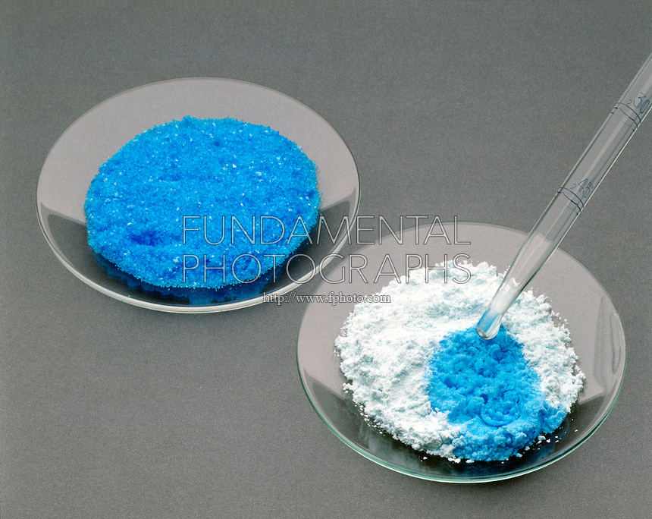
Are the crystals of salts really dry?
Water of crystallization is fixed number of water molecules chemically attached to each formula unit of a salt
Blue Copper sulphate crystals (CuSO_{4.}5H₂O)
seems to be dry contain water of crystallization
On heating, water is removed and it turns
White.(CuSO₄)

Slide 28
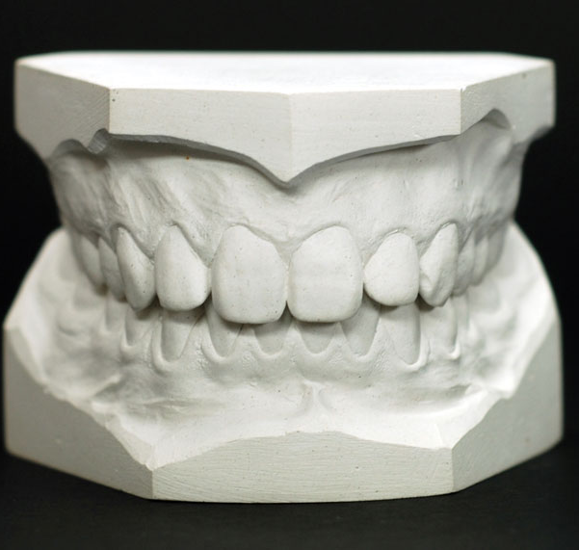
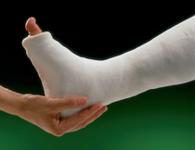
Plaster of Paris- Calcium sulphate hemihydrate - CaSO₄ 1/2H₂O or (CaSO₄) ₂H₂O
On mixing with water Plaster of Paris becomes hard solid mass of gypsum
CaSO₄ 1/2H₂O +3/2H₂O-------------→ CaSO₄2H₂O (gypsum)
One molecule of water is shared by 2 water molecules in POP
Uses
In making toys, decoration materials
In making surface smooth
For immobilizing broken bone

Slide 29
IMPORTANT LINKS FOR RESOURCE MATERIALS
https://diksha.gov.in/play/collection/do_31289123241963520013913?contentType=TextBook
https://bit.ly/term-10science
https://www.khanacademy.org/science/in-in-class-10-chemistry-india/x87dd2847d57ee419:in-in-acids-bases-and-salts
https://nroer.gov.in/55ab34ff81fccb4f1d806025/file/56cd6fbb81fccb54223d832f
https://nroer.gov.in/55ab34ff81fccb4f1d806025/page/58870b46472d4a1fef810919
https://nroer.gov.in/55ab34ff81fccb4f1d806025/file/5886e852472d4a1fef80f9cd

Slide 30
Assignment questions
Define olfactory indicators. Give example
What is neutralization reaction?
Why do acids not show acidic behavior in the absence of water?
Why does distilled water not conduct electricity where as rain water does?
What do you mean by water of crystallization?
Write the equation of “chlor alkali “ process.
What happens when a solution of sodium bicarbonate is heated?

Slide 31
Thank you

